Slide 1

Tweakipedia
Presented By:-
Jaykumar Sharma
Pragati Unde
Rujul Desai

Slide 2

Contents
Motivation
Problem Definition
Key Issues & alternatives
Related Work
Limitations
Approach
Validation & Conclusions
Future Work

Slide 3
Why Tweakipedia?
Tweakipedia is a prototype developed for any user who has to go through multiple steps of searching to get a piece of information
Hash tag words used on Twitter or on any other social media platforms are not always self explanatory
A hashtag is a keyword or phrase that is preceded by a hash (#) sign
Tweakipedia aims on making the life of its user simpler by making the 2 step process of seeing a trending term on twitter and going on Wikipedia and searching for that term into a single click step

Slide 4
Problem definition
The user is not always aware of the newly trending words, sometimes the unusual vocabulary words
The developed system will make the user aware about the current trends just on a click
User also has the option of searching a word he thinks should trend and the proposed system will redirect the user to Wikipedia page of that hash word (term)

Slide 5
Problem Definition
User’s unawareness about trending topics, jargons ..
Tedious task of looking up the hash tags over internet
Tweakipedia
Integrated retrieval and lookup service

Slide 6
Key issues
Looking up the hash word by copying it and searching on Wikipedia
For example a user does not know about #hurricanesandy happening in other part of the world
The pattern of URL used by Wikipedia is not uniform, also Wikipedia redirects some pages not following URL pattern but does not do so for some
On what basis should trending word list be created
Tweets displayed to user for entered hash word in search box should be ranked on what grounds

Slide 7
Alternatives to these issues
Use a search engine for getting information of unknown word
Stay ignorant about it and miss the trend

Slide 8
Related work
No system exists that can do what Twikipedia is doing
Few browsers that provide the plugins that give a short description when hovered over a word on the webpage being displayed

Slide 9
Limitations
The developed system will only search on Wikipedia
Not all the potential searches may lead to an existing wiki page

Slide 10
Current v/s Proposed Tool Procedure
Check twitter trend
New term or something you don't know about
Search for the term on wikipedia
Current Procedure
Check twitter trend
Click
Wikipedia Page for clicked trend
Proposed Tool

Slide 11
Approach
Data
Algorithm
Inverted Index and Vector Space Model(VSM)
Link
Data set collection
Data Preprocessing
Tweakipedia
Servlet
Android Application

Slide 12
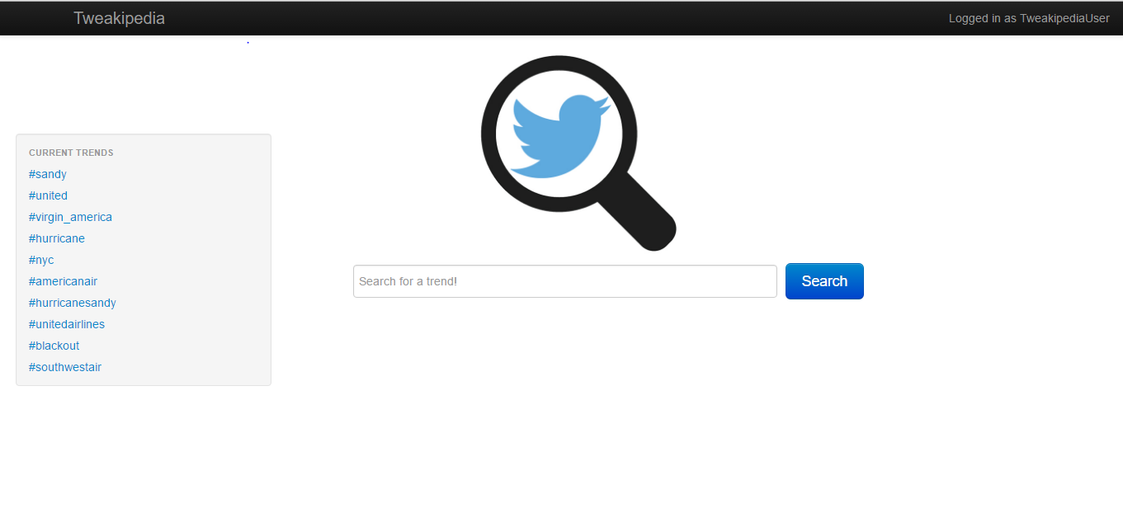
How does it look?
Based on document frequency

Slide 13
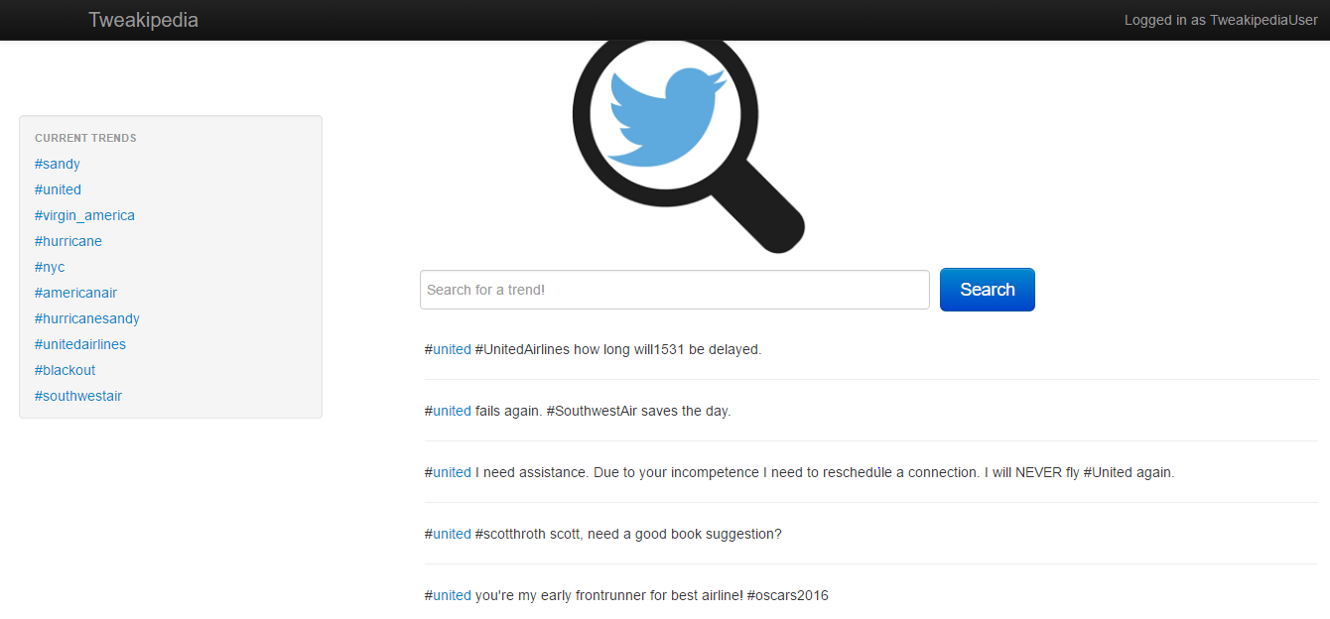
How does it look?
Based on VSM Score

Slide 14
Validation
Initially only inverted index was used for building information system and retrieving relevant documents
But for the ease of the user now only top 5 tweets based on VSM score are displayed to user, thus increasing usability
Search results when linked to Wikipedia give desired results in most of the cases

Slide 15
Conclusions
Tweakipedia being a prototype is developed so this concept can be integrated in complex business world problems
In today’s high speed world saving even 10 seconds of user becomes important for a social media platform. Tweakipedia does this and on a single click gives user information about the word he/she clicked

Slide 16
Future work
We can use Twitter live API for capturing live tweets instead of static data set used currently
We can have our own dictionary created (initially manually) for some common twitter hash words like #throwbackthursday
Can be integrated to existing applications as plugin

